Slide 1
CONTROL STATEMENTS
KOTAPPA Y GANDUDI

Slide 2
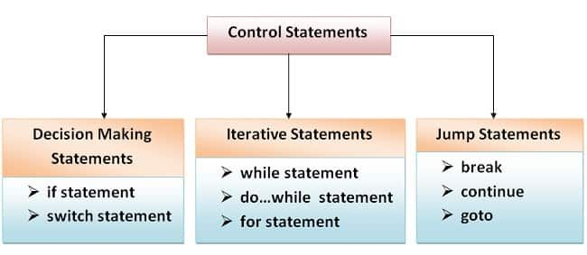
CONTROL STATEMENTS

Slide 3
IF STATEMENT
Syntax
if(condition)
{
statements;
}

Slide 4
EXAMPLE
int a=10,b=20;
if(a<b)
{
printf(“%d is smallest”,a);
}

Slide 5
IF-ELSE STATEMENT
Syntax
if(condition)
{
statement 1;
}
else
{
statement 2;
}

Slide 6
EXAMPLE
int a=10,b=20;
if(a<b)
{
printf(“%d is smallest”,a);
}
else
{
printf(“%d is smallest”,b);
}

Slide 7
ELSE-IF LADDER
Syntax
if(condition)
{
Statement 1;
}
else if(condition)
{
Statement 2;
}
.
.
else
{
Statement 3;
}

Slide 8
EXAMPLE
int a=10,b=20;
if(a<b)
{
printf(“%d is smallest”,a);
}
else if(a==b)
{
printf(“%d is equal to %d”,a,b);
}
else
{
printf(“%d is smallest”,b);
}

Slide 9
NESTED IF-ELSE
Syntax
if(condition)
{
if(condition)
{
statement 1;
}
else
{
statement 2;
}
}
else
{
if(condition)
{
statement 3;
}
else
{
statement 4;
}
}

Slide 10
EXAMPLE
int a=2,b=1,c=6;
if(a>b)
{
if(a>c)
{
printf(“%d is largest”,a);
}
else
{
printf(“%d is largest”,c);
}
}
else if(b>c)
{
printf(“%d is largest”,b);
}
else
{
printf(“%d is largest”,c);
}

Slide 11
SWITCH STATEMENT
Syntax
switch(choice)
{
case 1: statement 1;
break;
case 2: statement 2;
break;
.
.
default: statement n;
}

Slide 12
EXAMPLE
int a,b,ch;
switch(ch)
{
case ‘+’:printf(“%d”,a+b);
break;
case ‘-’:printf(“%d”,a-b);
break;
case ‘*’printf(“%d”,a*b);
break;
case ‘/’:printf(“%d”,a/b);
break;
case ‘%’”printf(“%d”,a%b);
break;
default:printf(“enter valid choice”);
}

Slide 13
ITERATIVE STATEMENTS
1. WHILE LOOP
2. DO WHILE LOOP
3. FOR LOOP

Slide 14
WHILE LOOP
Syntax
initialisation;
while(condition)
{
statements;
updadation;
}

Slide 15
EXAMPLE
int i=0;
while(i<10)
{
printf(“%d”,i);
i++;
}

Slide 16
DO WHILE LOOP
Syntax
initialisation;
do
{
statements;
updadation;
}while(condition);

Slide 17
EXAMPLE
int i=10;
do
{
if(i%2==0)
{
printf(“%d”,i);
}
i--;
}while(i>0);

Slide 18
FOR LOOP
Syntax
for(initialisation;condition;updadation)
{
statements;
}

Slide 19
EXAMPLE
for(int i=1;i<=10;i++)
{
printf(“%d*%d=%d”,5,i,5*i);
}

Slide 20
BREAK GOTO and CONTINUE
BREAK
Break statement is used in loops.
Break statement is used to forcefully come out of the loops.
EXAMPLE
for(i=0;i<10;i++)
{
if(i==3)
{
break;
}
printf(“%d”,i);
}

Slide 21
BREAK GOTO and CONTINUE
GOTO
Goto is used to go to a particular part of code
EXAMPLE
printf(“hello AIET”);
goto x;
x:
printf(“hello CSE”);

Slide 22
BREAK GOTO and CONTINUE
CONTINUE
It is used to skip some part of the code in the program and continue the next iterations.
EXAMPLE
for(int i=0;i<10;i++)
{
if(i==3)
{
continue;
}
printf(“%d”,i);
}

